Slide 1

VIETNAM NATIONAL UNIVERSITY HO CHI MINH CITY
HO CHI MINH CITY UNIVERSITY OF TECHNOLOGY
FACULTY OF ELECTRICAL AND ELECTRONICS ENGINEERING
DEPARTMENT OF ELECTRONICS ENGINEERING
CAPSTONE PROJECT 1
DESIGN AND VERIFICATION OF
A 5-STAGE PIPELINED RISC-V PROCESSOR
Instructor: Dr. Trần Hoàng Linh
Student: Nguyễn Duy Ngọc
Student ID: 2251036
Ho Chi Minh City – June 5, 2025

Slide 2
CONTENTS
Introduction
Design Theory and Interest
Design Specifications
Block Diagrams
Input – Output Description
Functional Description
RTL Simulation Results
Synthesis
Working Directory
Conclusion and Future Vision
Department of Electronics Engineering Capstone Project 1 Nguyễn Duy Ngọc June 5, 2025

Slide 3
1. INTRODUCTION
Project objectives
Theoretical study of pipelining and the RV32I instruction set
Control unit and data path design
Implementation and testbench development
RTL verification and simulation
Synthesis and FPGA proof-of-concept
Department of Electronics Engineering Capstone Project 1 Nguyễn Duy Ngọc June 5, 2025

Slide 4
1. INTRODUCTION
Motivation for choosing the project
Gain experience in designing a RISC-V pipelined processor to deepen understanding of processor microarchitecture.
Enhance skills in digital design using System Verilog, Verilator, GTKWave, and Quartus Prime.
Align with career orientation in IC design and verification.
Department of Electronics Engineering Capstone Project 1 Nguyễn Duy Ngọc June 5, 2025

Slide 5
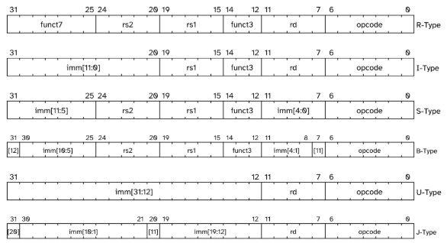
2. DESIGN THEORY AND INTEREST
RV32I Instruction Set
Department of Electronics Engineering Capstone Project 1 Nguyễn Duy Ngọc June 5, 2025

Slide 6
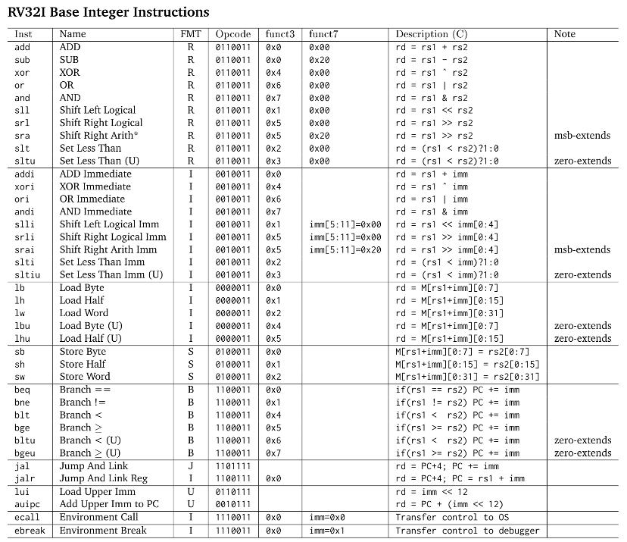
2. DESIGN THEORY AND INTEREST
RV32I Instruction Set
Department of Electronics Engineering Capstone Project 1 Nguyễn Duy Ngọc June 5, 2025

Slide 7
2. DESIGN THEORY AND INTEREST
RV32I Instruction Set
Department of Electronics Engineering Capstone Project 1 Nguyễn Duy Ngọc June 5, 2025

Slide 8
2. DESIGN THEORY AND INTEREST
Microarchitecture
Single-cycle
Executes an entire instruction in 1 cycle
Simple control unit
Cycle time is limited by the slowest instruction
Does not require any non-architectural state
Department of Electronics Engineering Capstone Project 1 Nguyễn Duy Ngọc June 5, 2025

Slide 9
2. DESIGN THEORY AND INTEREST
Microarchitecture
Multi-cycle
Executes 1 instruction at a time, taking shorter clock cycles
Simpler instructions execute in fewer cycles
Reduces cost by reusing expensive hardware blocks
Requires non-architectural registers to hold intermediate results
Department of Electronics Engineering Capstone Project 1 Nguyễn Duy Ngọc June 5, 2025

Slide 10
2. DESIGN THEORY AND INTEREST
Microarchitecture
Pipelined
Applies pipelining to the single-cycle microarchitecture
Executes several instructions simultaneously
Improves the throughput
Requires non-architectural pipeline registers, hazard handler
Department of Electronics Engineering Capstone Project 1 Nguyễn Duy Ngọc June 5, 2025

Slide 11
2. DESIGN THEORY AND INTEREST
Pipeline Stages
Fetch: Reads instruction from instruction memory using current program counter (PC)
Decode: Decodes instruction & reads operands from register file
Execute: Performs arithmetic/logic operations using ALU or calculates effective address for memory instructions
Memory: Performs data read or write (if required)
Write-back: Result is written back to register file (if required)
Department of Electronics Engineering Capstone Project 1 Nguyễn Duy Ngọc June 5, 2025

Slide 12
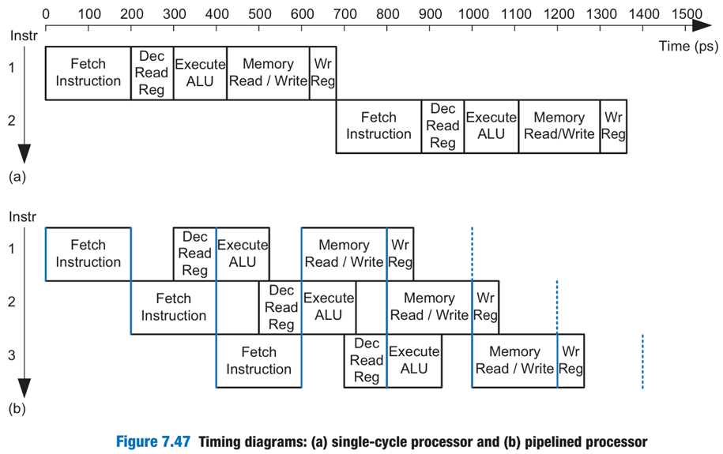
2. DESIGN THEORY AND INTEREST
Timing diagram: (a) single-cycle processor and (b) pipelined processor
Department of Electronics Engineering Capstone Project 1 Nguyễn Duy Ngọc June 5, 2025

Slide 13
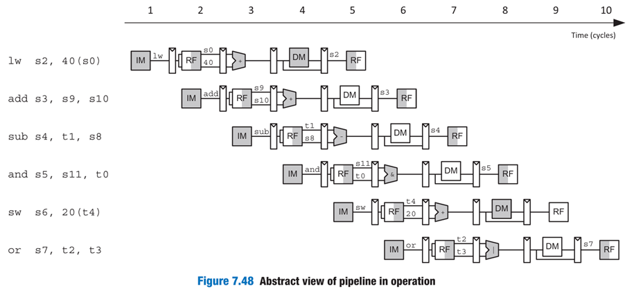
2. DESIGN THEORY AND INTEREST
Abstract view of pipeline in operation
Department of Electronics Engineering Capstone Project 1 Nguyễn Duy Ngọc June 5, 2025

Slide 14
2. DESIGN THEORY AND INTEREST
Hazards in Pipelining
Read after write (RAW) data hazards: An instruction depends on a result that has not yet been written into register file
→ Forwarding (if result is computed soon enough) or
Stalling (until the result is available)
Department of Electronics Engineering Capstone Project 1 Nguyễn Duy Ngọc June 5, 2025

Slide 15
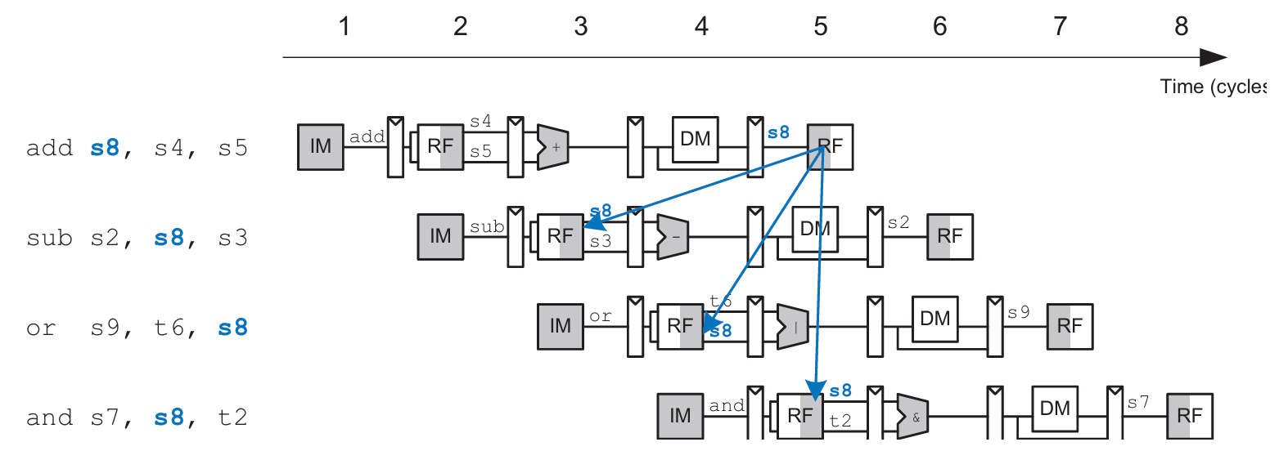
2. DESIGN THEORY AND INTEREST
RAW data hazard
Department of Electronics Engineering Capstone Project 1 Nguyễn Duy Ngọc June 5, 2025

Slide 16
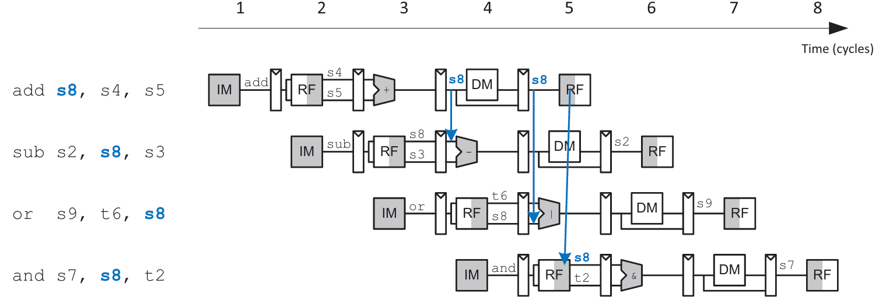
2. DESIGN THEORY AND INTEREST
Solve RAW data hazard with forwarding
Department of Electronics Engineering Capstone Project 1 Nguyễn Duy Ngọc June 5, 2025

Slide 17
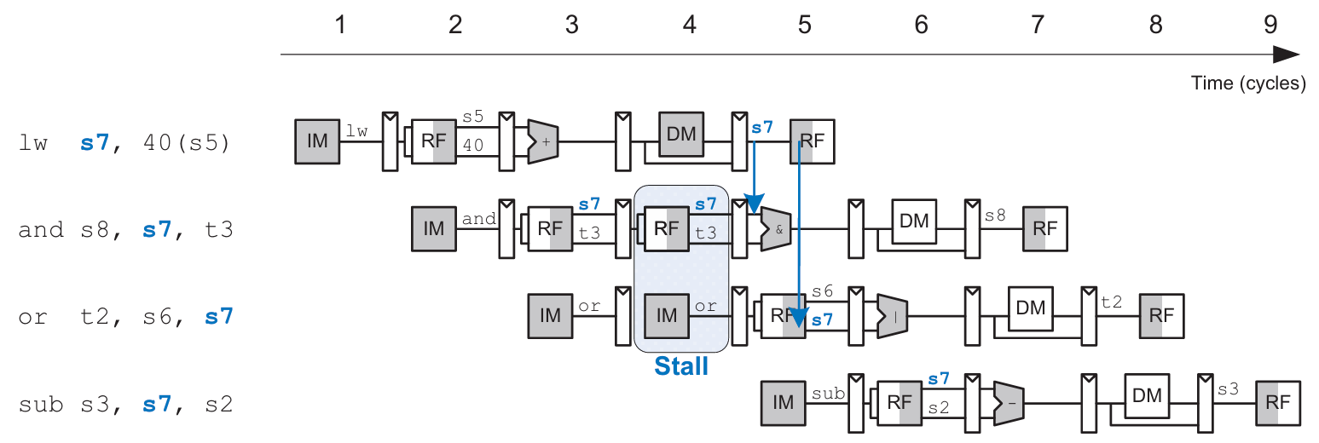
2. DESIGN THEORY AND INTEREST
Solve load RAW data hazard with stalling
Department of Electronics Engineering Capstone Project 1 Nguyễn Duy Ngọc June 5, 2025

Slide 18
2. DESIGN THEORY AND INTEREST
Hazards in Pipelining
Control hazards: Decision of what instruction to fetch has not been made by the time the next instruction must be fetched
→ Predicting branches are not taken
→ If branch taken, 2 following instructions are flushed (branch misprediction penalty)
Department of Electronics Engineering Capstone Project 1 Nguyễn Duy Ngọc June 5, 2025

Slide 19
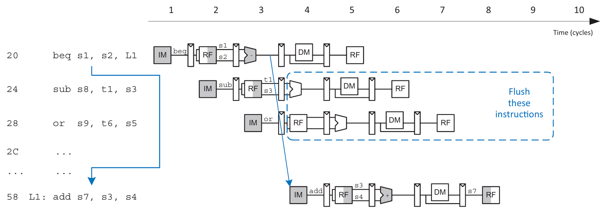
2. DESIGN THEORY AND INTEREST
Solve control hazards with flushing (branch misprediction penalty)
Department of Electronics Engineering Capstone Project 1 Nguyễn Duy Ngọc June 5, 2025

Slide 20
3. DESIGN SPECIFICATIONS
Support 39 RV32I instructions
Fully pipelined: Fetch, Decode, Execute, Memory, Write-back
Synthesizable on Altera DE10 FPGA
→ Significantly higher instruction throughput and efficient resource utilization
→ Must address hazards and ensure correctness using a hazard unit and forwarding logic
Department of Electronics Engineering Capstone Project 1 Nguyễn Duy Ngọc June 5, 2025

Slide 21
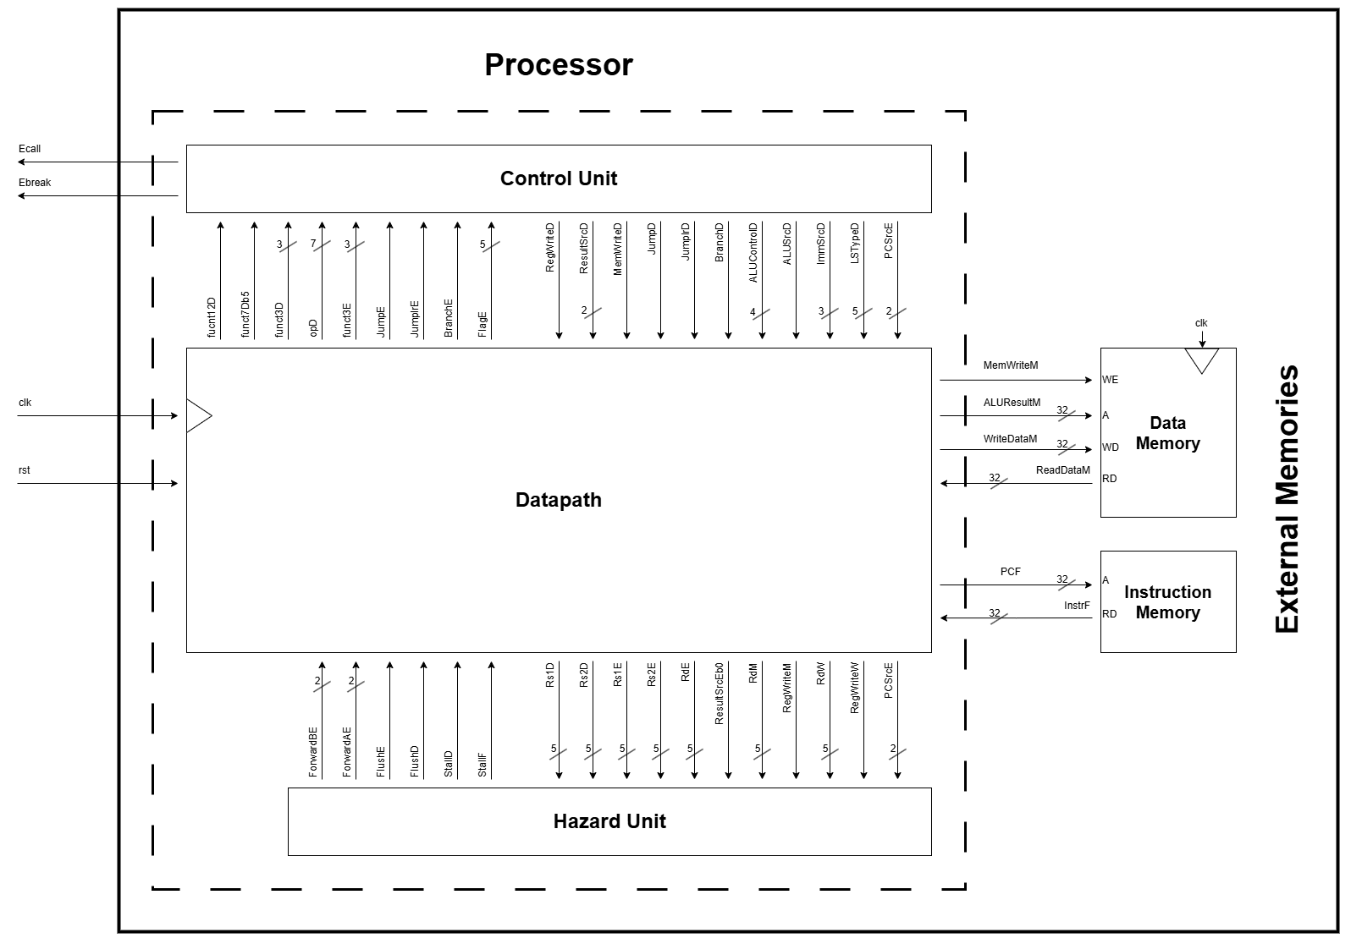
4. BLOCK DIAGRAMS
Top level
Processor
Data Path
Control Unit
Hazard Unit
Instruction memory
Data memory
Department of Electronics Engineering Capstone Project 1 Nguyễn Duy Ngọc June 5, 2025

Slide 22
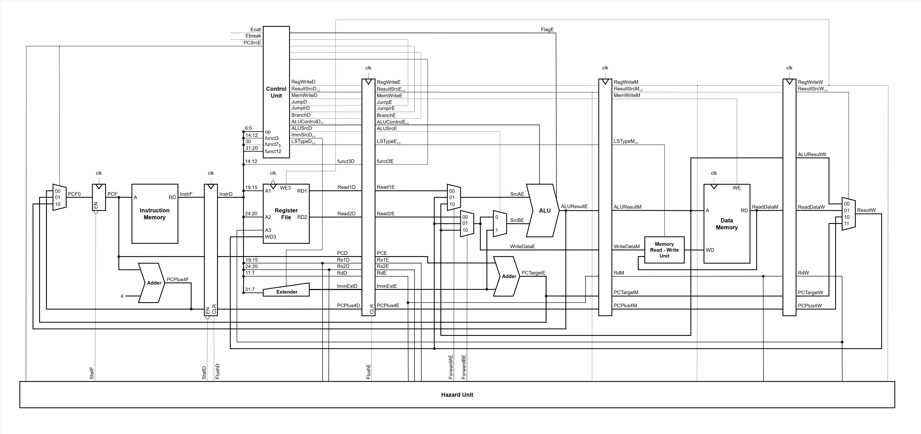
4. BLOCK DIAGRAMS
Data Path
Department of Electronics Engineering Capstone Project 1 Nguyễn Duy Ngọc June 5, 2025

Slide 23

4. BLOCK DIAGRAMS
Data Path – Fetch stage
Multiplexer: PC selection
Pipeline register
Adder: Next PC calculation
Department of Electronics Engineering Capstone Project 1 Nguyễn Duy Ngọc June 5, 2025

Slide 24
4. BLOCK DIAGRAMS
Data Path – Decode stage
Pipeline register
Register file
Immediate extender
Department of Electronics Engineering Capstone Project 1 Nguyễn Duy Ngọc June 5, 2025

Slide 25
4. BLOCK DIAGRAMS
Data Path – Execute stage
Pipeline register
Multiplexers: ALU sources selections
Adder: Branch/jump target PC calculation
Arithmetic Logic Unit (ALU)
Department of Electronics Engineering Capstone Project 1 Nguyễn Duy Ngọc June 5, 2025

Slide 26
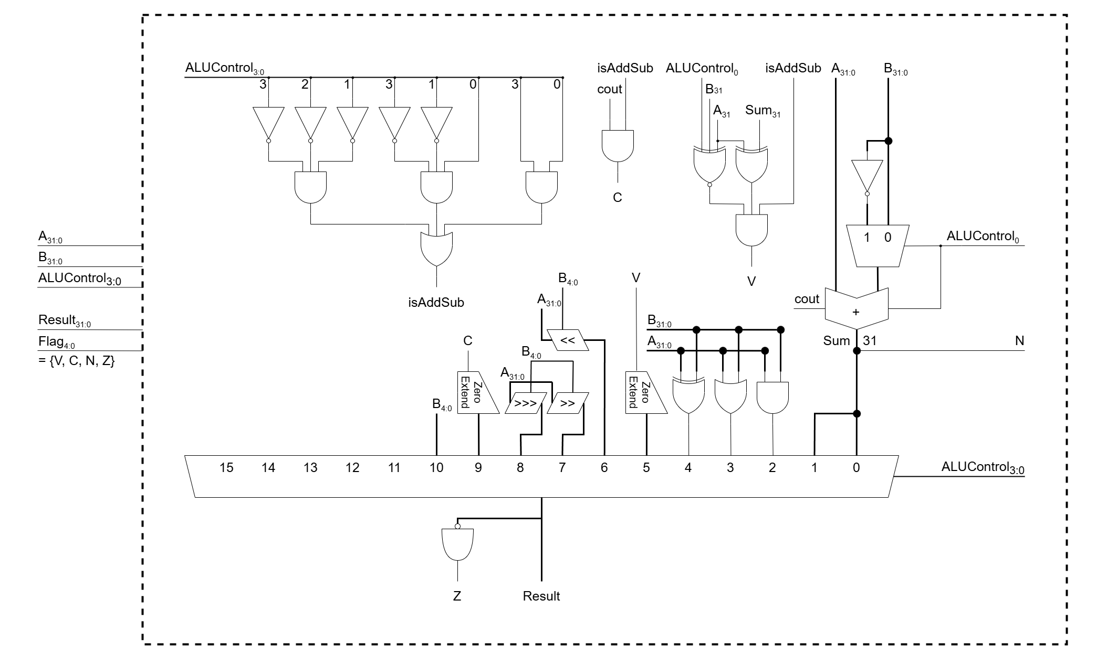
4. BLOCK DIAGRAMS
Arithmetic Logic Unit (ALU)
Department of Electronics Engineering Capstone Project 1 Nguyễn Duy Ngọc June 5, 2025

Slide 27
4. BLOCK DIAGRAMS
Data Path – Memory stage
Pipeline register
Memory Read – Write Unit
Department of Electronics Engineering Capstone Project 1 Nguyễn Duy Ngọc June 5, 2025

Slide 28
4. BLOCK DIAGRAMS
Data path – Write-back stage
Pipeline register
Multiplexer: Result selection
Department of Electronics Engineering Capstone Project 1 Nguyễn Duy Ngọc June 5, 2025

Slide 29
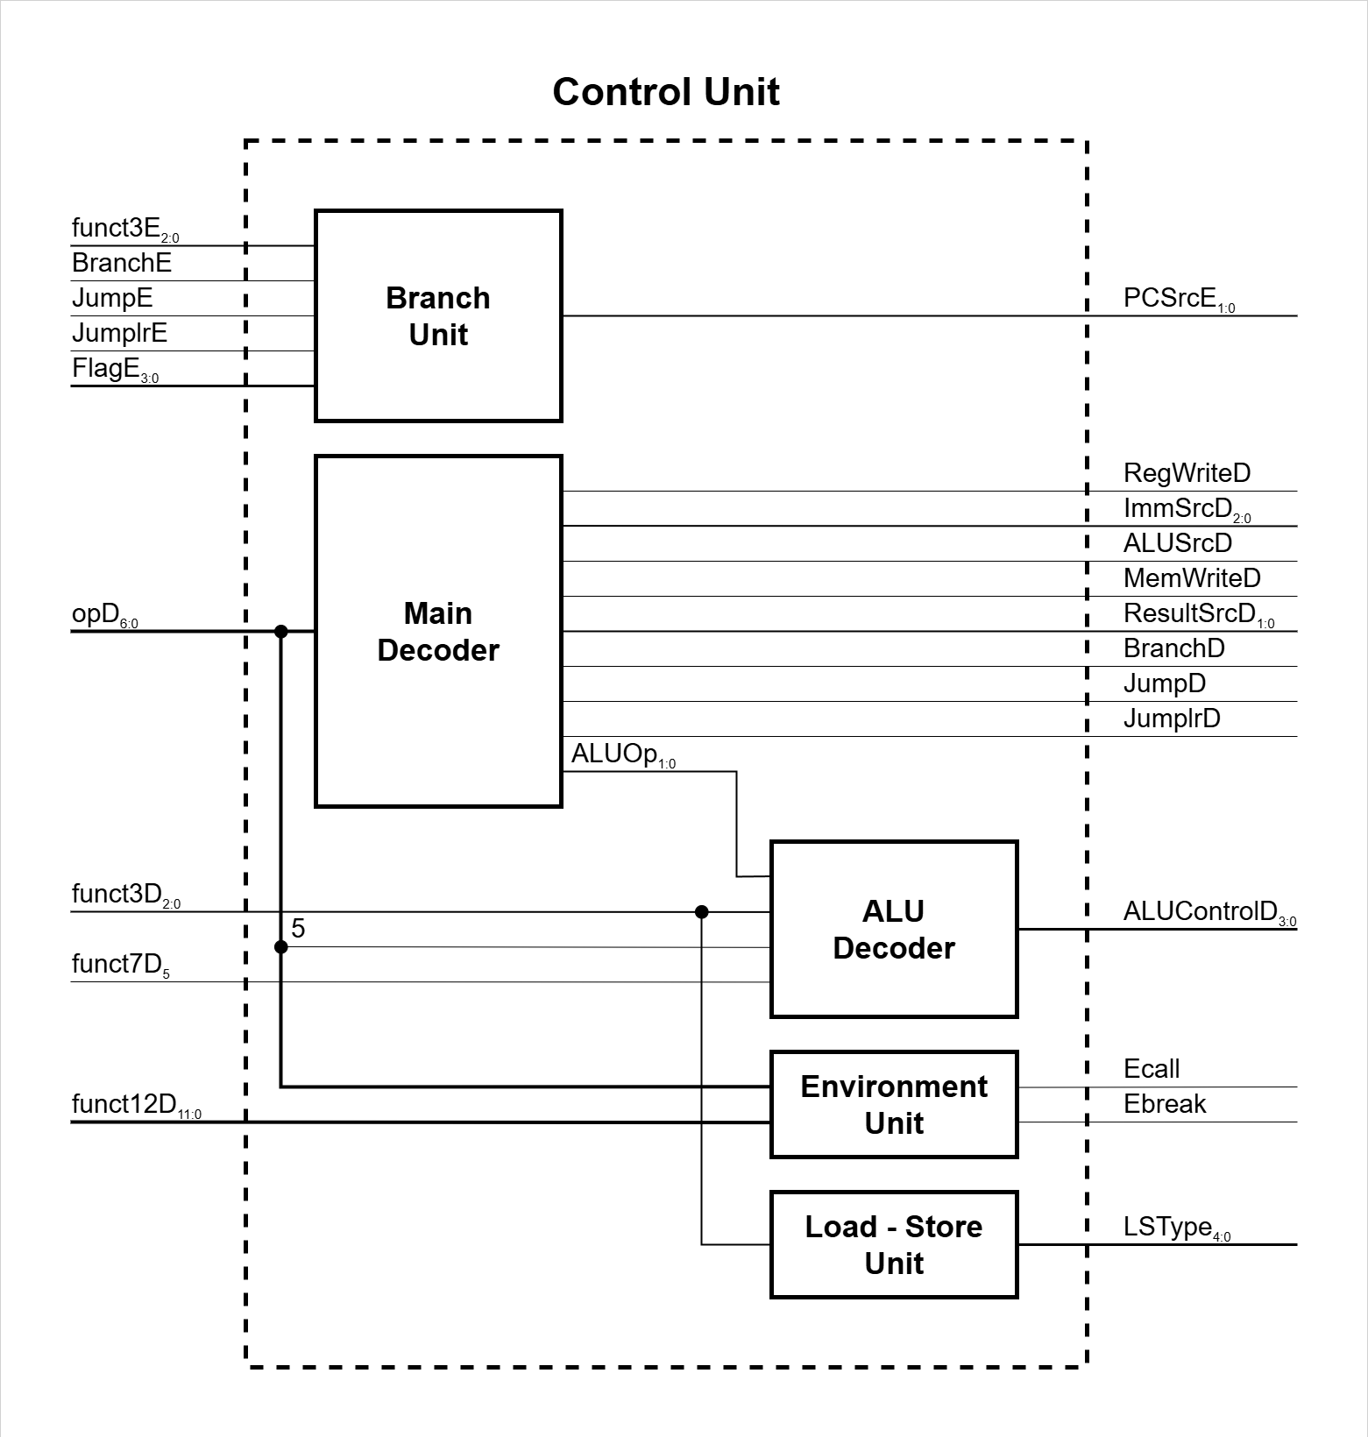
4. BLOCK DIAGRAMS
Control Unit
Department of Electronics Engineering Capstone Project 1 Nguyễn Duy Ngọc June 5, 2025

Slide 30
4. BLOCK DIAGRAMS
Control Unit & Data Path
Department of Electronics Engineering Capstone Project 1 Nguyễn Duy Ngọc June 5, 2025

Slide 31
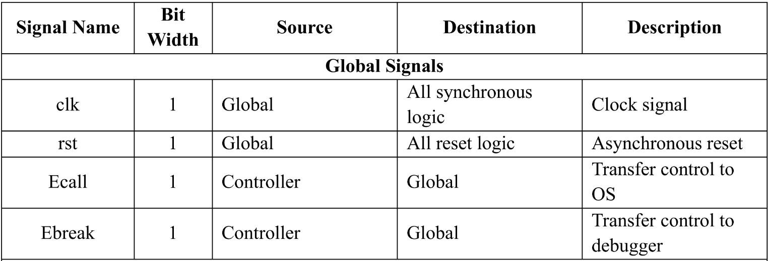
5. INPUT – OUTPUT DESCRIPTION
Department of Electronics Engineering Capstone Project 1 Nguyễn Duy Ngọc June 5, 2025

Slide 32
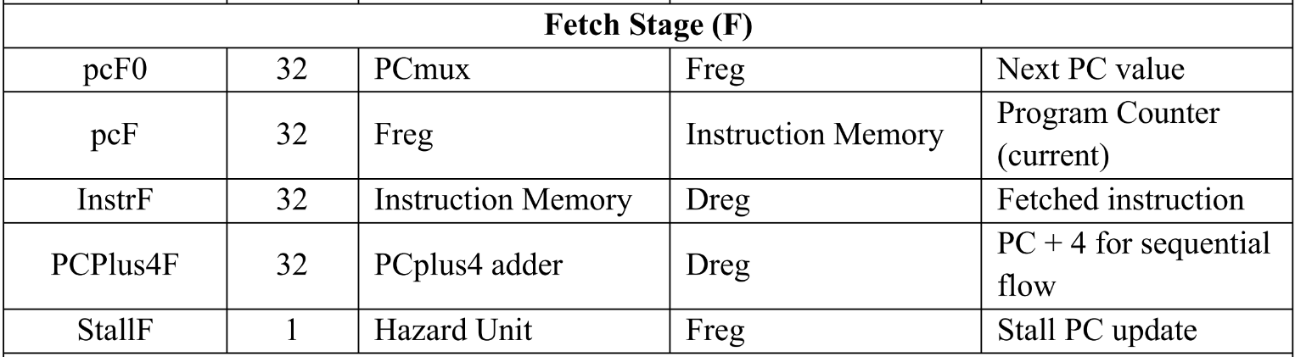
5. INPUT – OUTPUT DESCRIPTION
Department of Electronics Engineering Capstone Project 1 Nguyễn Duy Ngọc June 5, 2025

Slide 33
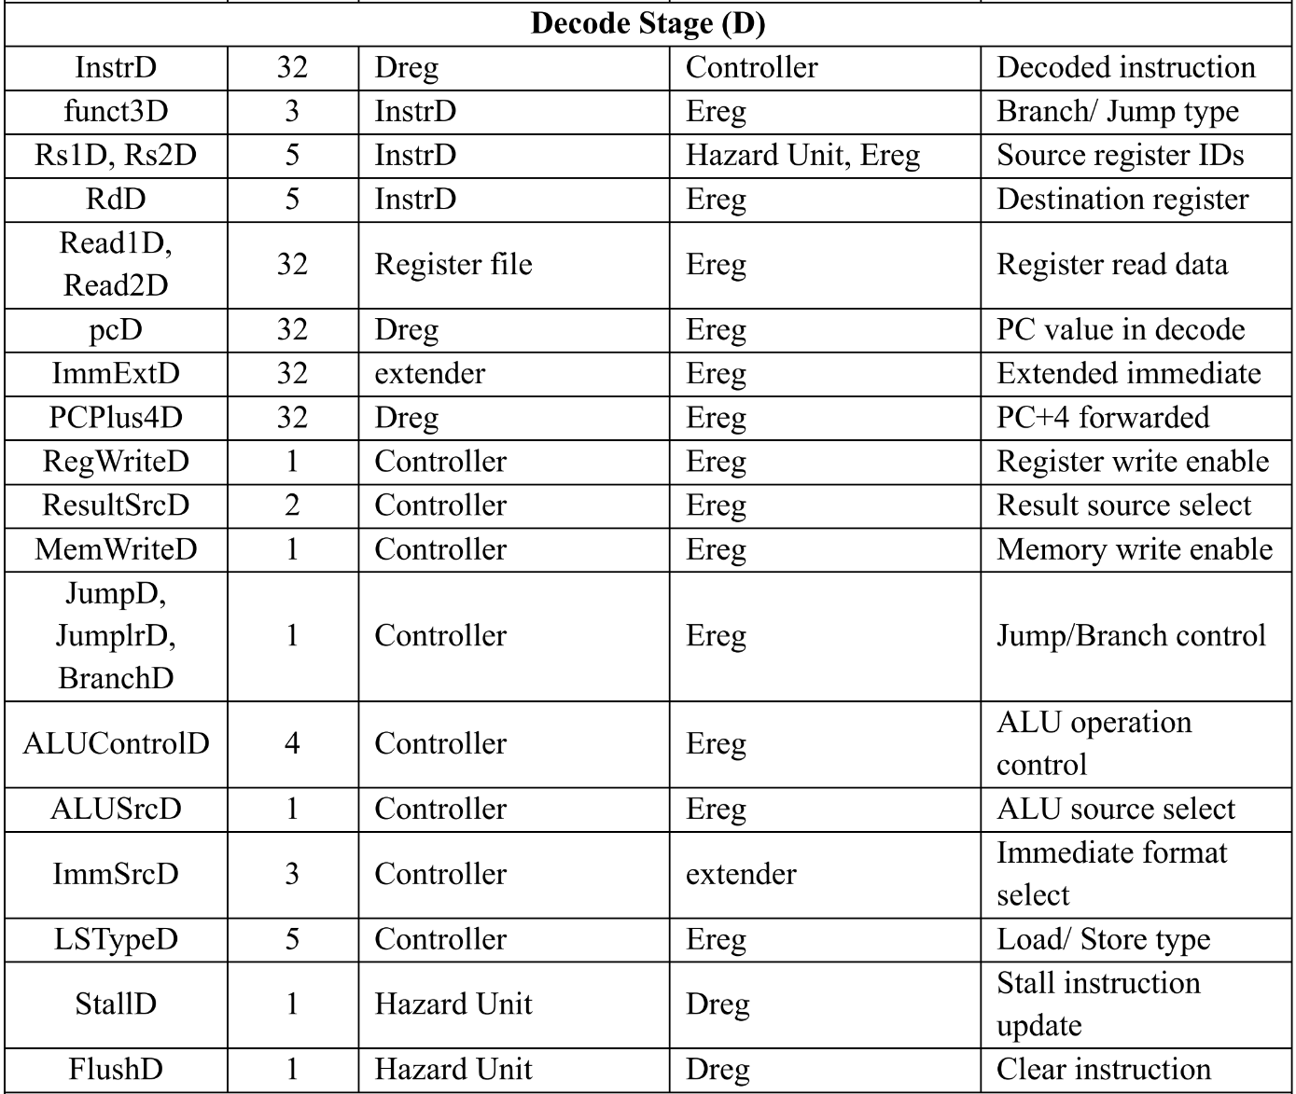
5. INPUT – OUTPUT DESCRIPTION
Department of Electronics Engineering Capstone Project 1 Nguyễn Duy Ngọc June 5, 2025

Slide 34
5. INPUT – OUTPUT DESCRIPTION
Department of Electronics Engineering Capstone Project 1 Nguyễn Duy Ngọc June 5, 2025

Slide 35
6. FUNCTIONAL DESCRIPTION
Fetch stage
PC selects address to be fetched from Instruction Memory.
Retrieved instruction is passed to Decode stage via pipeline register.
Simultaneously, PC + 4 is computed using adder and forwarded to support control transfer instructions.
Department of Electronics Engineering Capstone Project 1 Nguyễn Duy Ngọc June 5, 2025

Slide 36
6. FUNCTIONAL DESCRIPTION
Decode stage
Instruction is decoded to extract opcode, funct3, funct7, Rd, Rs1, Rs2, and immediate.
Register File provides source register values based on Rs1D, Rs2D address.
Immediate Extender, controlled by ImmSrcD, generates extended immediate value.
Department of Electronics Engineering Capstone Project 1 Nguyễn Duy Ngọc June 5, 2025

Slide 37
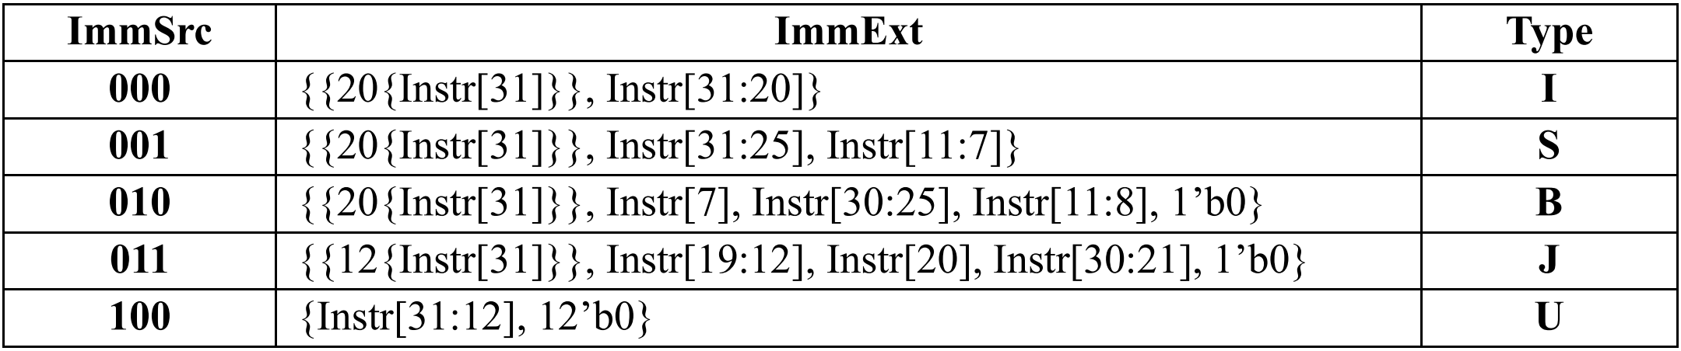
6. FUNCTIONAL DESCRIPTION
Immediate extender truth table

Slide 38
6. FUNCTIONAL DESCRIPTION
Decode stage
Main Decoder uses opcode to generate control signals: register write enable, memory write enable, ALU operation selector, result source, and branch/jump indicators.
ALU Decoder further decodes ALU operation from the ALUop, funct3, and funct7 fields.
Department of Electronics Engineering Capstone Project 1 Nguyễn Duy Ngọc June 5, 2025

Slide 39
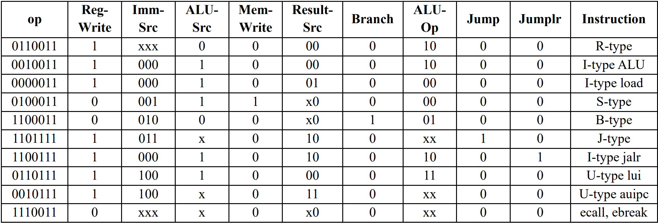
6. FUNCTIONAL DESCRIPTION
Main Decoder truth table
Department of Electronics Engineering Capstone Project 1 Nguyễn Duy Ngọc June 5, 2025

Slide 40
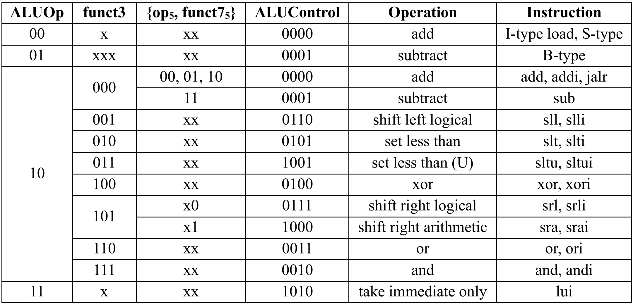
6. FUNCTIONAL DESCRIPTION
ALU Decoder truth table
Department of Electronics Engineering Capstone Project 1 Nguyễn Duy Ngọc June 5, 2025

Slide 41
6. FUNCTIONAL DESCRIPTION
Decode stage
Environment Unit (EU) computes ecall/ebreak output signal from funct12.
Department of Electronics Engineering Capstone Project 1 Nguyễn Duy Ngọc June 5, 2025

Slide 42
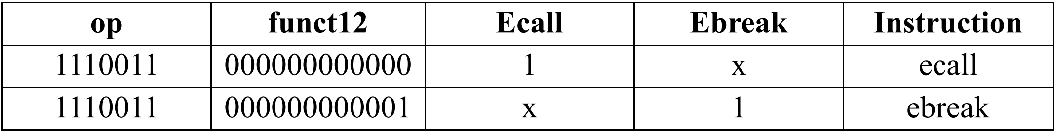
6. FUNCTIONAL DESCRIPTION
Environment Unit (EU) truth table
Department of Electronics Engineering Capstone Project 1 Nguyễn Duy Ngọc June 5, 2025

Slide 43
6. FUNCTIONAL DESCRIPTION
Decode stage
If instruction is a memory access type (lw, lh, lb, sw, sh, sb), Load Store Unit (LSU) uses funct3 to determine load/store size and type.
Department of Electronics Engineering Capstone Project 1 Nguyễn Duy Ngọc June 5, 2025

Slide 44
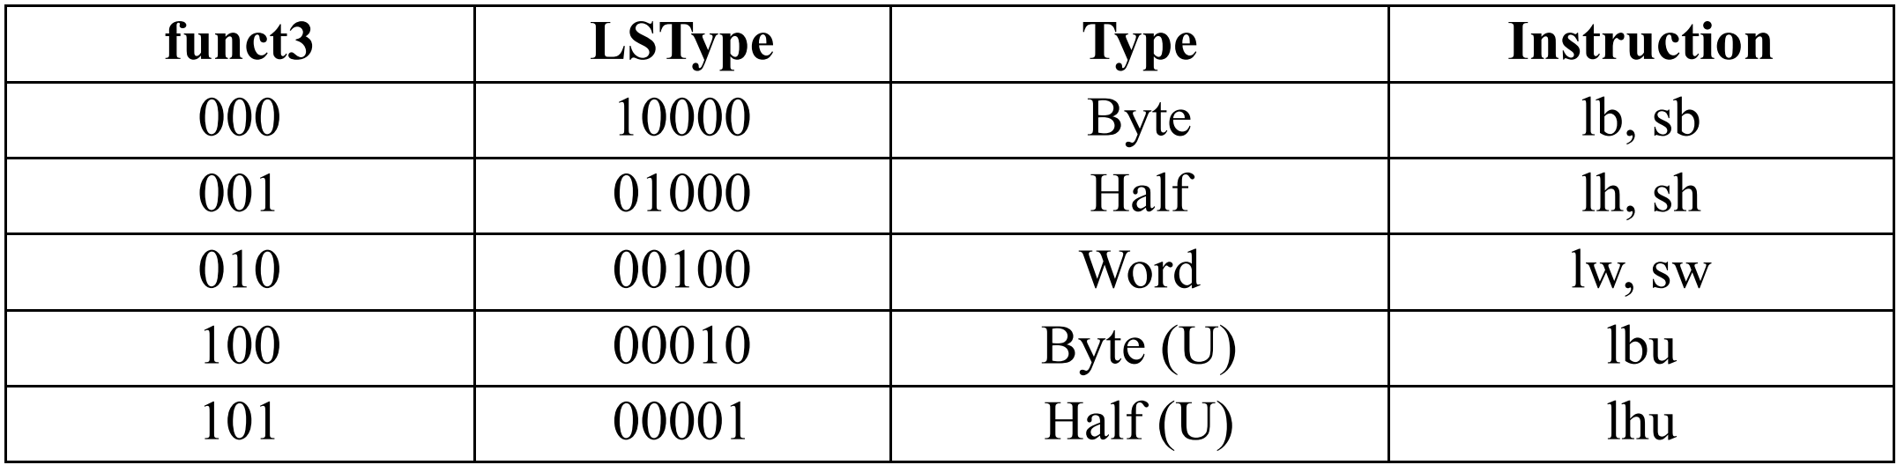
6. FUNCTIONAL DESCRIPTION
Load – Store Unit (LSU) truth table
Department of Electronics Engineering Capstone Project 1 Nguyễn Duy Ngọc June 5, 2025

Slide 45
6. FUNCTIONAL DESCRIPTION
Execute stage
ALU operands are selected via muxes controlled by ForwardAE, ForwardBE signals (from Hazard Unit): Determine whether to use forwarded data or not
Department of Electronics Engineering Capstone Project 1 Nguyễn Duy Ngọc June 5, 2025

Slide 46
6. FUNCTIONAL DESCRIPTION
Execute stage
ALU source B is selected via mux controlled by ALUSrcE signal (from Control Unit): Determine whether to use register read data or extended immediate.
Department of Electronics Engineering Capstone Project 1 Nguyễn Duy Ngọc June 5, 2025

Slide 47
6. FUNCTIONAL DESCRIPTION
Execute stage
ALU executes arithmetic/logic operation defined by ALUControlE, producing ALUResultE and FlagE (Z, N, V, C).
Department of Electronics Engineering Capstone Project 1 Nguyễn Duy Ngọc June 5, 2025

Slide 48
6. FUNCTIONAL DESCRIPTION
Execute stage
Branch Unit (BRU) computes branch decision (PCSrcE) based on flags and control signals. PC is updated via PCSrcE if a branch is taken.
Department of Electronics Engineering Capstone Project 1 Nguyễn Duy Ngọc June 5, 2025

Slide 49
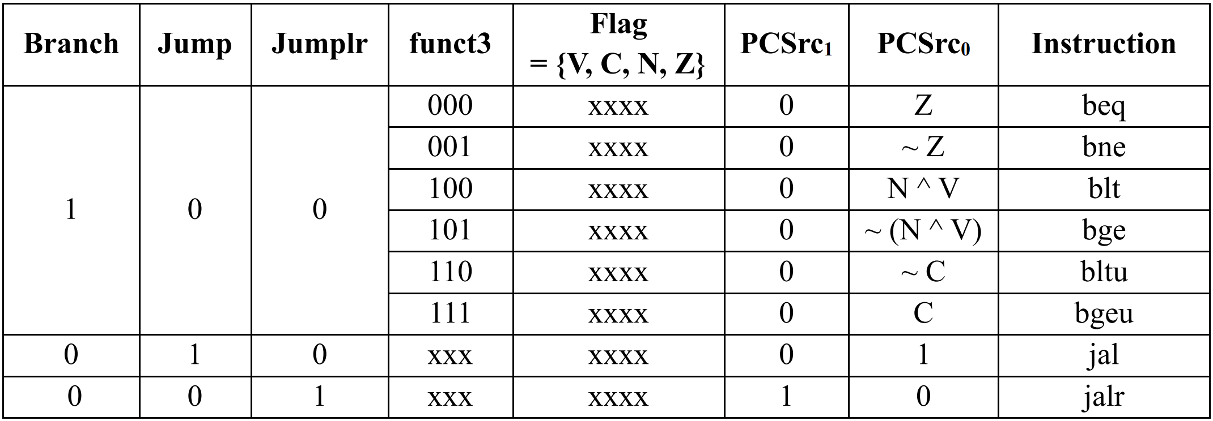
6. FUNCTIONAL DESCRIPTION
Branch Unit (BU) truth table
Department of Electronics Engineering Capstone Project 1 Nguyễn Duy Ngọc June 5, 2025

Slide 50
6. FUNCTIONAL DESCRIPTION
Execute stage
Jump and Link (jal, jalr) instructions write PC + 4 to the destination register and make jump decision (PCSrcE).
Department of Electronics Engineering Capstone Project 1 Nguyễn Duy Ngọc June 5, 2025

Slide 51
6. FUNCTIONAL DESCRIPTION
Execute stage
Target PC for branch/jump is computed from current PC and immediate by an adder.
Department of Electronics Engineering Capstone Project 1 Nguyễn Duy Ngọc June 5, 2025

Slide 52
6. FUNCTIONAL DESCRIPTION
Memory stage
Data is either read from memory (ReadDataW) or written (WriteDataM) based on MemWriteM.
Department of Electronics Engineering Capstone Project 1 Nguyễn Duy Ngọc June 5, 2025

Slide 53
6. FUNCTIONAL DESCRIPTION
Write-back stage
Result is selected based on ResultSrcW: ALU result, memory data, PC + 4, or PCTarget.
Result is written back to Register File at destination register (RdW), if RegWriteW is asserted.
Department of Electronics Engineering Capstone Project 1 Nguyễn Duy Ngọc June 5, 2025

Slide 54
6. FUNCTIONAL DESCRIPTION
RAW data hazard handling
Forwarding:
Rs1E = RdM != 0, RegWriteM = 1
→ ForwardAE = 10
Rs1E = RdW != 0, RegWriteW = 1
→ ForwardAE = 01
Department of Electronics Engineering Capstone Project 1 Nguyễn Duy Ngọc June 5, 2025

Slide 55
6. FUNCTIONAL DESCRIPTION
Load data hazard handling
Stalling:
ResultSrcEb0 = 1, Rs1D = RdE
ResultSrcEb0 = 1, Rs2D = RdE
→ StallF = StallD = FlushE = 1
Department of Electronics Engineering Capstone Project 1 Nguyễn Duy Ngọc June 5, 2025

Slide 56
6. FUNCTIONAL DESCRIPTION
Control hazard handling
Flushing:
PCSrcE != 00
→ FlushD = FlushE = 1
Department of Electronics Engineering Capstone Project 1 Nguyễn Duy Ngọc June 5, 2025

Slide 57
7. RTL SIMULATION RESULTS
Verification method
Bottom-up verification: submodules, data path stages, top level
Full coverage of instruction types
Tools: Verilator, GTKWave
Department of Electronics Engineering Capstone Project 1 Nguyễn Duy Ngọc June 5, 2025

Slide 58
7. RTL SIMULATION RESULTS
Testbench setup
Instruction memory initialization
DUT and memories instantiation with debugging signals
Clock and reset generation
Monitoring and logging
Waveform generation
Department of Electronics Engineering Capstone Project 1 Nguyễn Duy Ngọc June 5, 2025

Slide 59
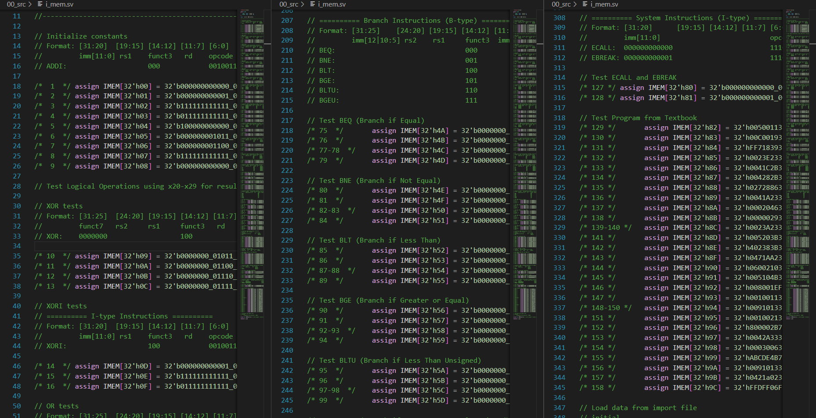
7. RTL SIMULATION RESULTS
Instruction memory initialization with 156 test cases for RV32I instructions
Department of Electronics Engineering Capstone Project 1 Nguyễn Duy Ngọc June 5, 2025

Slide 60
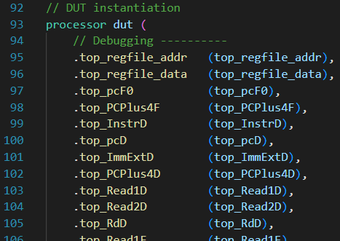
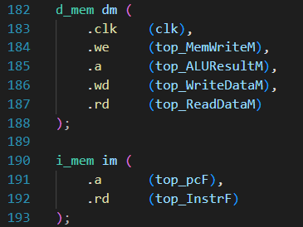
7. RTL SIMULATION RESULTS
DUT and memories instantiation with debugging signals
Department of Electronics Engineering Capstone Project 1 Nguyễn Duy Ngọc June 5, 2025

Slide 61
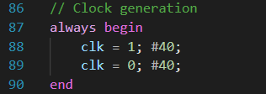
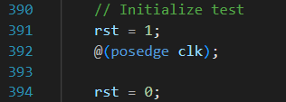
7. RTL SIMULATION RESULTS
Clock and reset generation
Department of Electronics Engineering Capstone Project 1 Nguyễn Duy Ngọc June 5, 2025

Slide 62
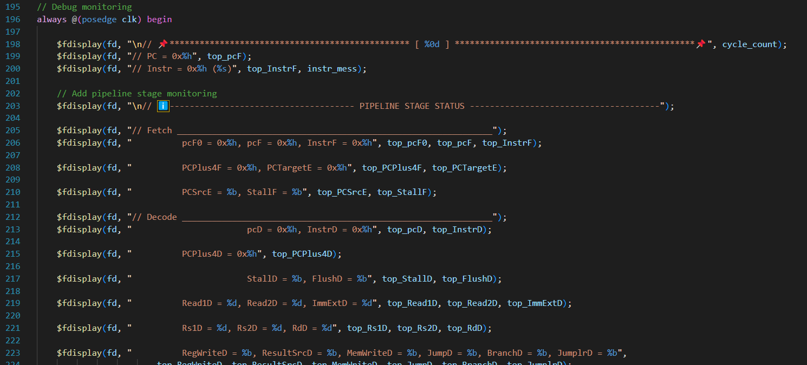
7. RTL SIMULATION RESULTS
Results monitoring
Department of Electronics Engineering Capstone Project 1 Nguyễn Duy Ngọc June 5, 2025

Slide 63
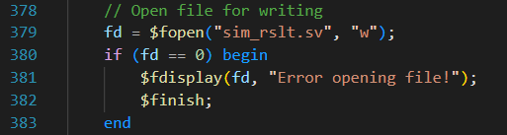
7. RTL SIMULATION RESULTS
Results logging
Department of Electronics Engineering Capstone Project 1 Nguyễn Duy Ngọc June 5, 2025

Slide 64
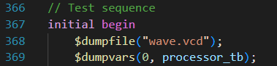
7. RTL SIMULATION RESULTS
Waveform generating
Department of Electronics Engineering Capstone Project 1 Nguyễn Duy Ngọc June 5, 2025

Slide 65
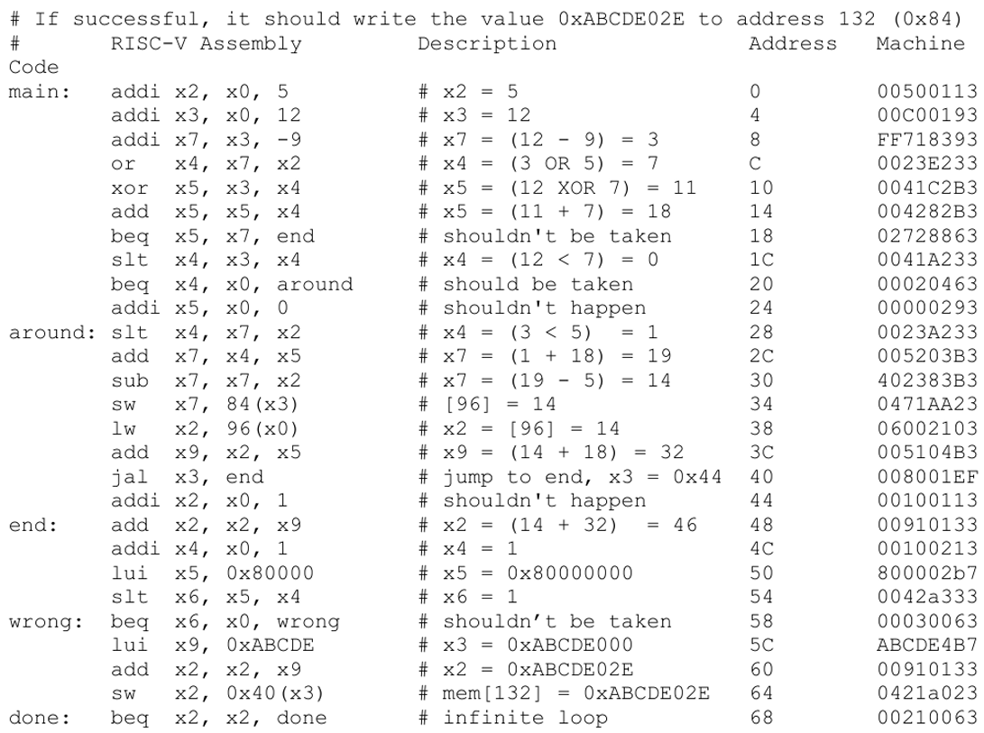
7. RTL SIMULATION RESULTS
Test program 1
Include simple arithmetic, logic, branching, jump, and memory operations.
Result (0xABCDE02E) is written to memory address 0x84.
All hazards are effectively handled via forwarding, flushing, and stalling.
Department of Electronics Engineering Capstone Project 1 Nguyễn Duy Ngọc June 5, 2025

Slide 66
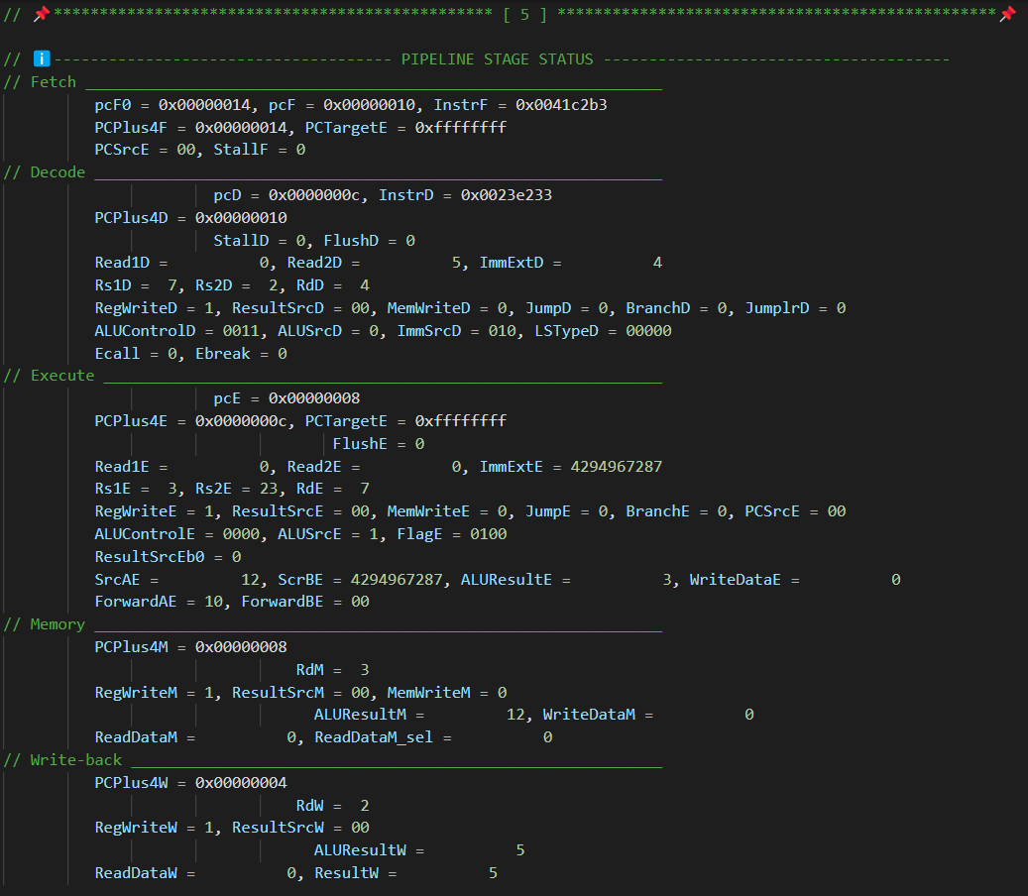
7. RTL SIMULATION RESULTS
Displayed pipeline stage status from simulation at cycle 5,
when the first 5 instructions are at 5 different stages of the processor
Department of Electronics Engineering Capstone Project 1 Nguyễn Duy Ngọc June 5, 2025

Slide 67
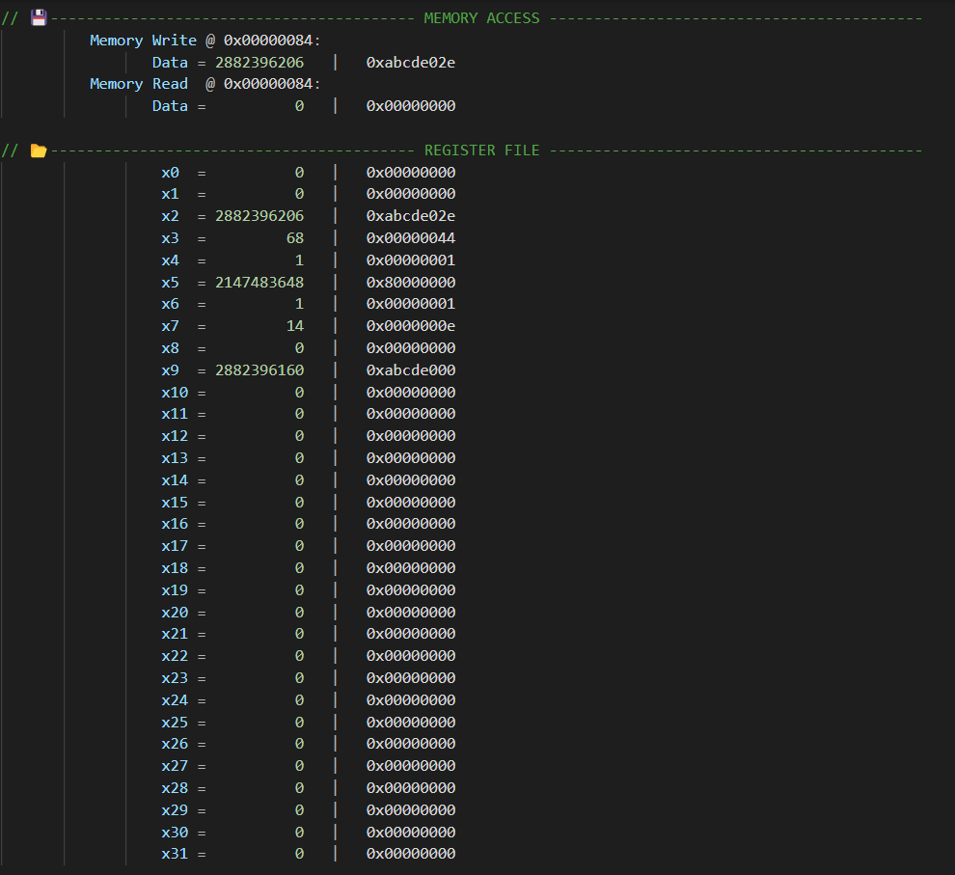
7. RTL SIMULATION RESULTS
Displayed memory and register file data from simulation at cycle 32, when all instructions have been executed
Department of Electronics Engineering Capstone Project 1 Nguyễn Duy Ngọc June 5, 2025

Slide 68
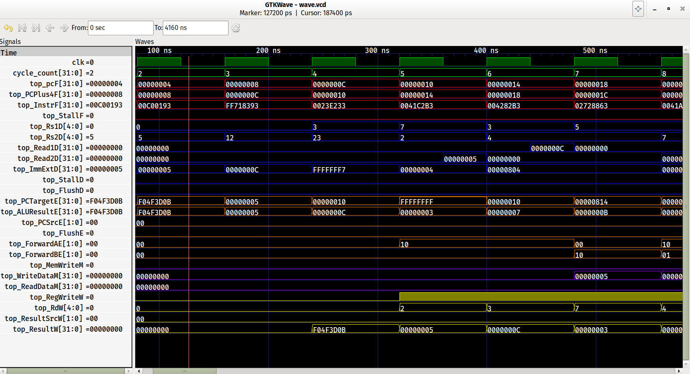
7. RTL SIMULATION RESULTS
Forwarding occurs at cycle 5 for [add x7, x4, x5] followed by [sub x7, x7, x2]
Department of Electronics Engineering Capstone Project 1 Nguyễn Duy Ngọc June 5, 2025

Slide 69
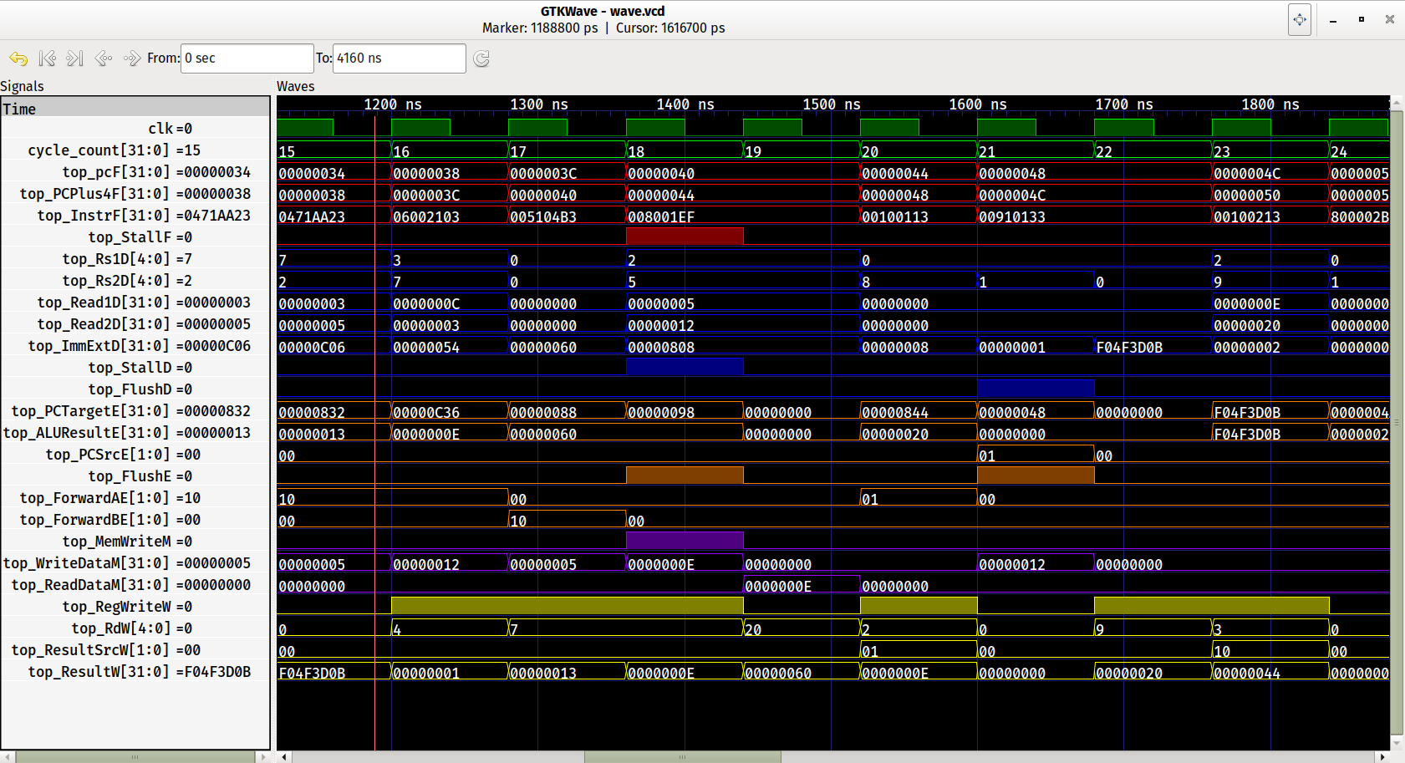
7. RTL SIMULATION RESULTS
Stall occurs at cycle 18 for [lw x2, 96(x0)] followed by [add x9, x2, x5]
Department of Electronics Engineering Capstone Project 1 Nguyễn Duy Ngọc June 5, 2025

Slide 70
7. RTL SIMULATION RESULTS
Branch non-taken at cycle 8, branch taken at cycle 11
for [beq x5, x7, end] and [beq x4, x0, around]
Department of Electronics Engineering Capstone Project 1 Nguyễn Duy Ngọc June 5, 2025

Slide 71
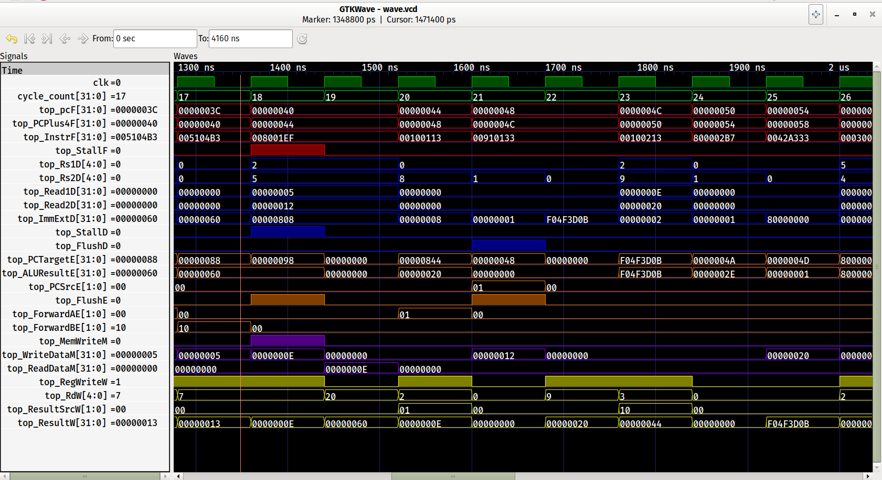
7. RTL SIMULATION RESULTS
Jump at cycle 21 for [jal x3, end]
Department of Electronics Engineering Capstone Project 1 Nguyễn Duy Ngọc June 5, 2025

Slide 72
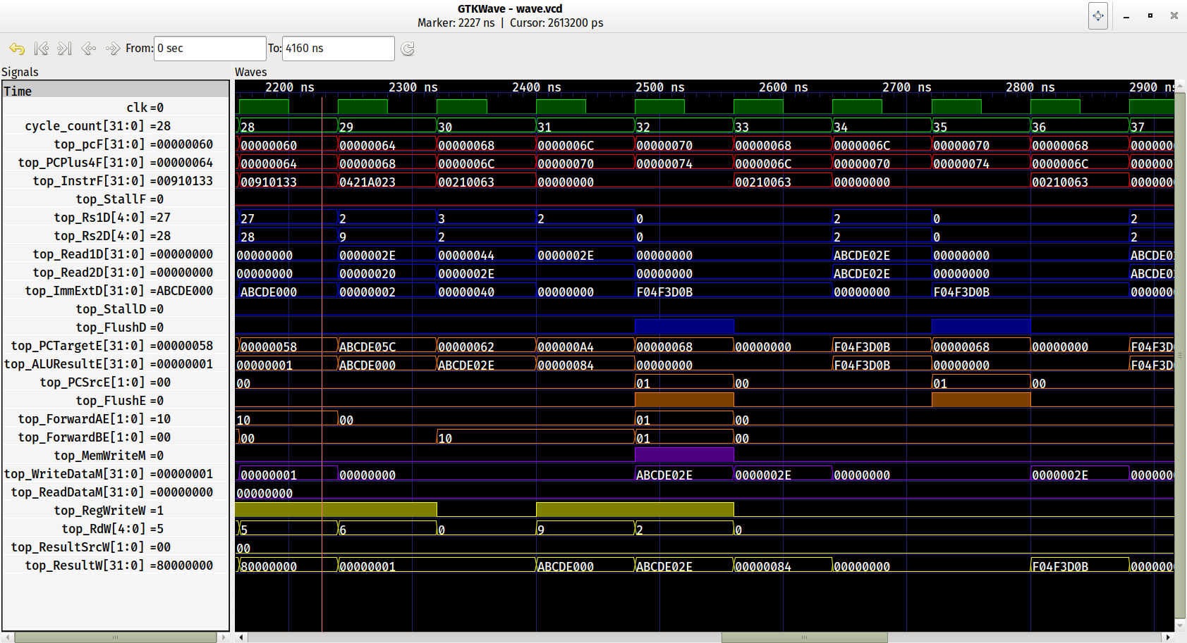
7. RTL SIMULATION RESULTS
Memory write at cycle 32 for [sw x2, 0x40(x3)]
Department of Electronics Engineering Capstone Project 1 Nguyễn Duy Ngọc June 5, 2025

Slide 73
8. SYNTHESIS
Synthesized using Quartus Prime
Top-level: Processor with instruction & data memories interfaces
Netlist views: top, processor, Control Unit (and submodules), Data Path (and ALU), Hazard Unit
Department of Electronics Engineering Capstone Project 1 Nguyễn Duy Ngọc June 5, 2025

Slide 74
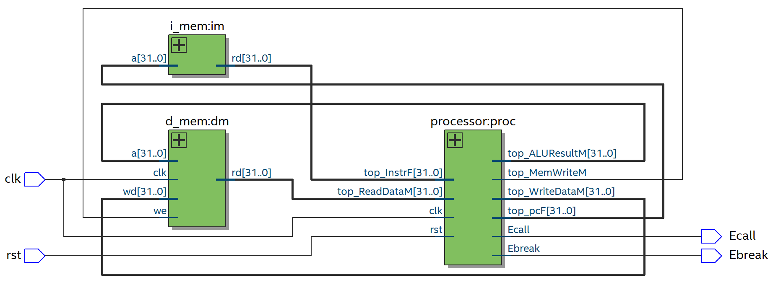
8. SYNTHESIS
Processor with External Instruction and Data Memory Interfaces
Department of Electronics Engineering Capstone Project 1 Nguyễn Duy Ngọc June 5, 2025

Slide 75
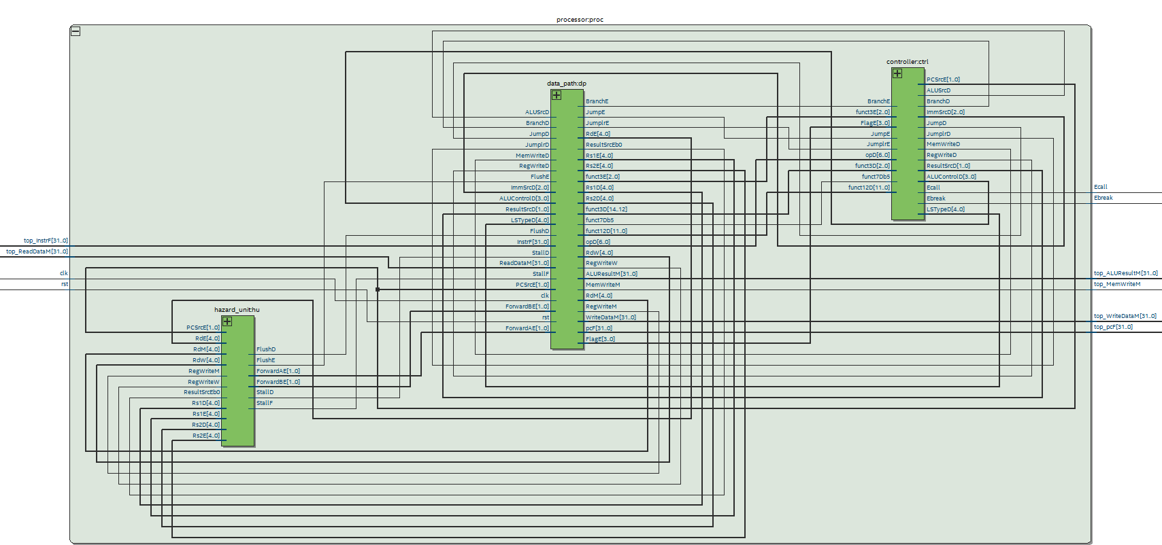
8. SYNTHESIS
Processor
Department of Electronics Engineering Capstone Project 1 Nguyễn Duy Ngọc June 5, 2025

Slide 76
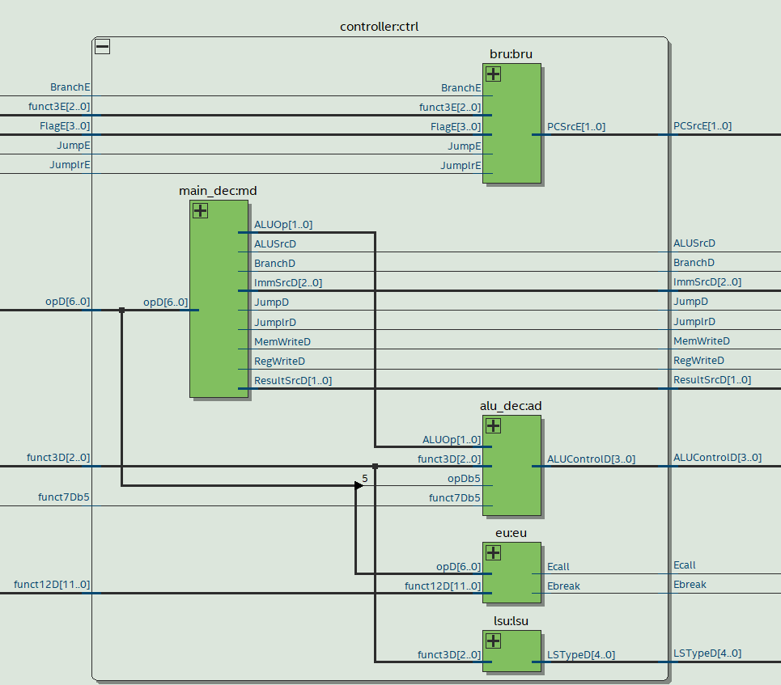
8. SYNTHESIS
Control Unit
Department of Electronics Engineering Capstone Project 1 Nguyễn Duy Ngọc June 5, 2025

Slide 77
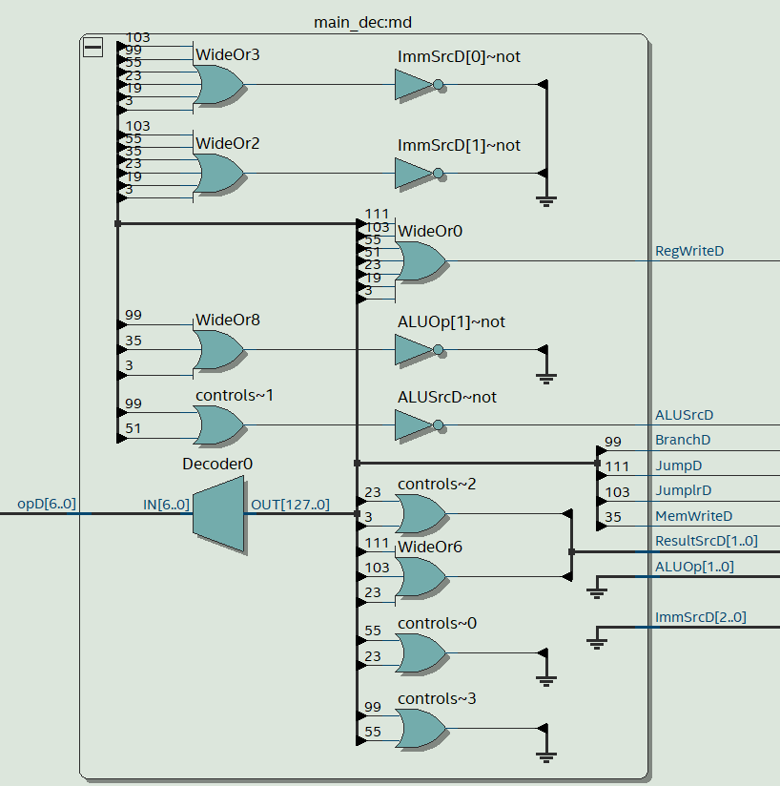
8. SYNTHESIS
Main decoder
Department of Electronics Engineering Capstone Project 1 Nguyễn Duy Ngọc June 5, 2025

Slide 78
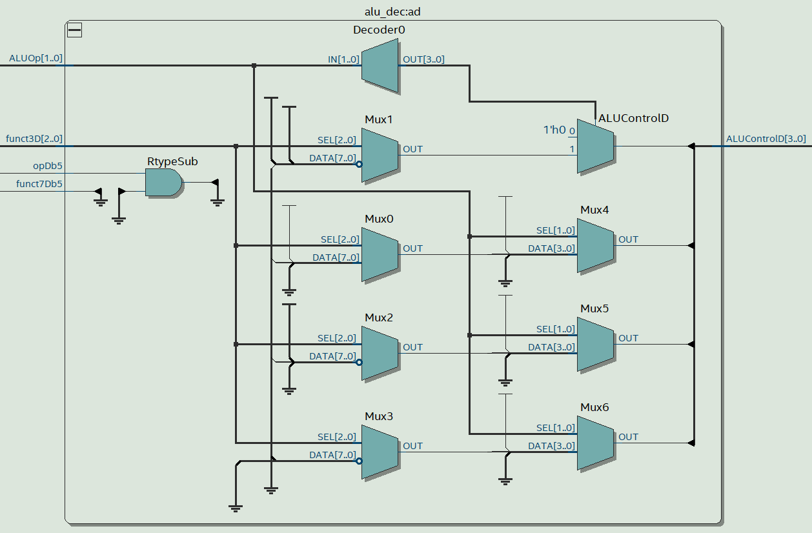
8. SYNTHESIS
ALU decoder
Department of Electronics Engineering Capstone Project 1 Nguyễn Duy Ngọc June 5, 2025

Slide 79
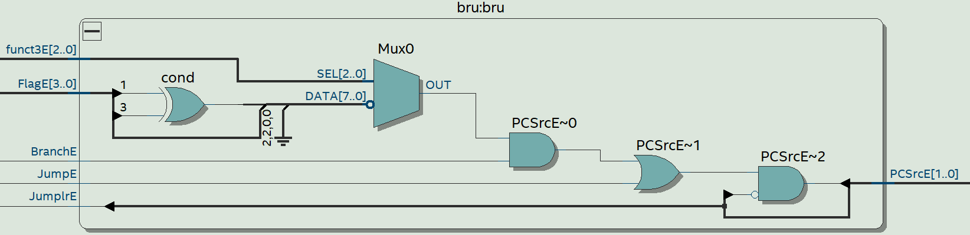
8. SYNTHESIS
Branch Unit (BRU)
Department of Electronics Engineering Capstone Project 1 Nguyễn Duy Ngọc June 5, 2025

Slide 80
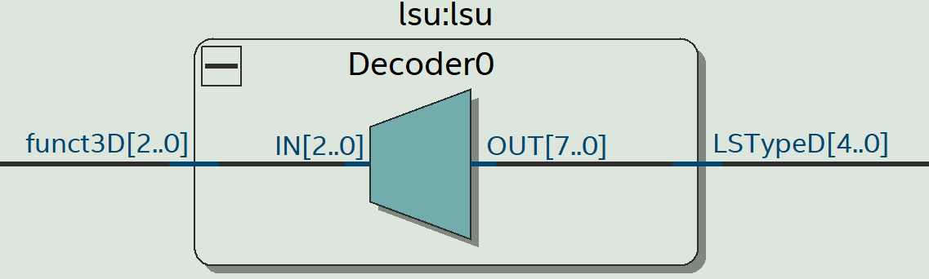
8. SYNTHESIS
Load – Store Unit (LSU)
Department of Electronics Engineering Capstone Project 1 Nguyễn Duy Ngọc June 5, 2025

Slide 81
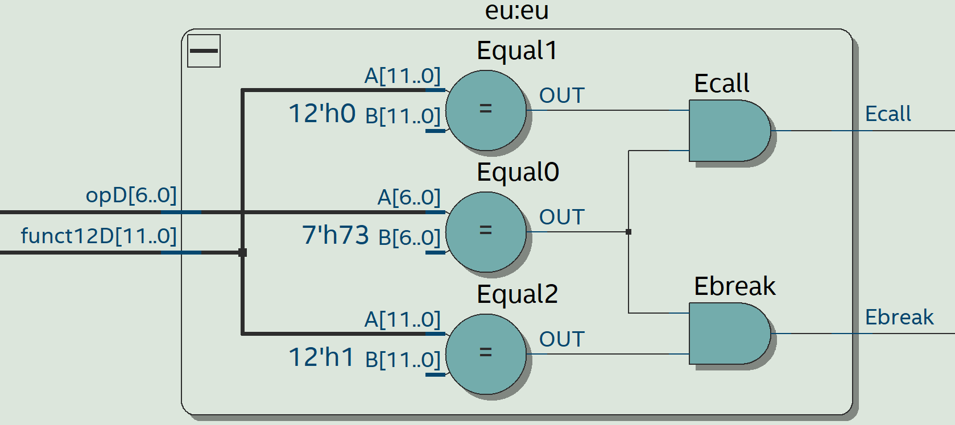
8. SYNTHESIS
Environment Unit (EU)
Department of Electronics Engineering Capstone Project 1 Nguyễn Duy Ngọc June 5, 2025

Slide 82
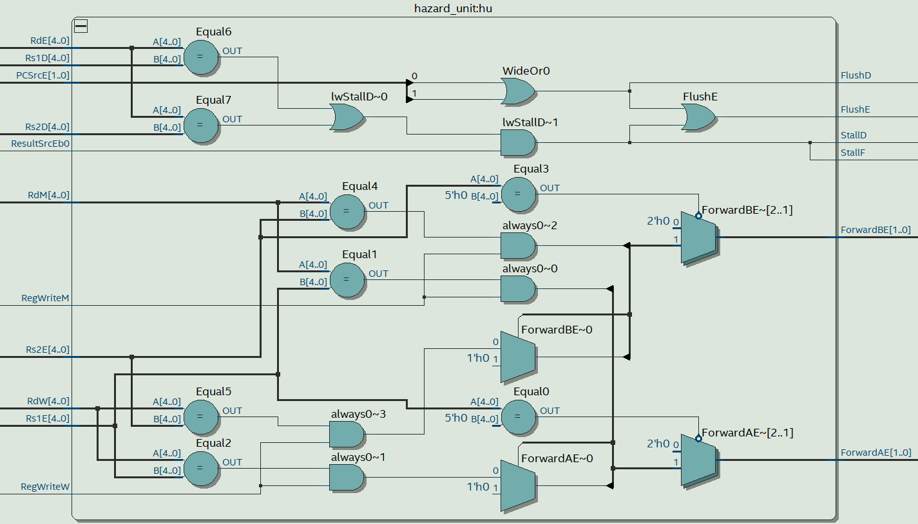
8. SYNTHESIS
Hazard Unit
Department of Electronics Engineering Capstone Project 1 Nguyễn Duy Ngọc June 5, 2025

Slide 83
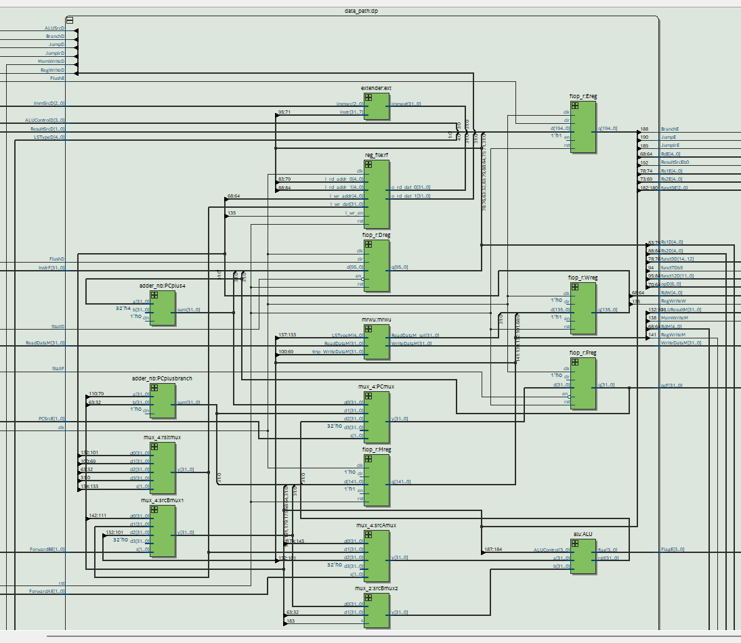
8. SYNTHESIS
Data path
Department of Electronics Engineering Capstone Project 1 Nguyễn Duy Ngọc June 5, 2025

Slide 84
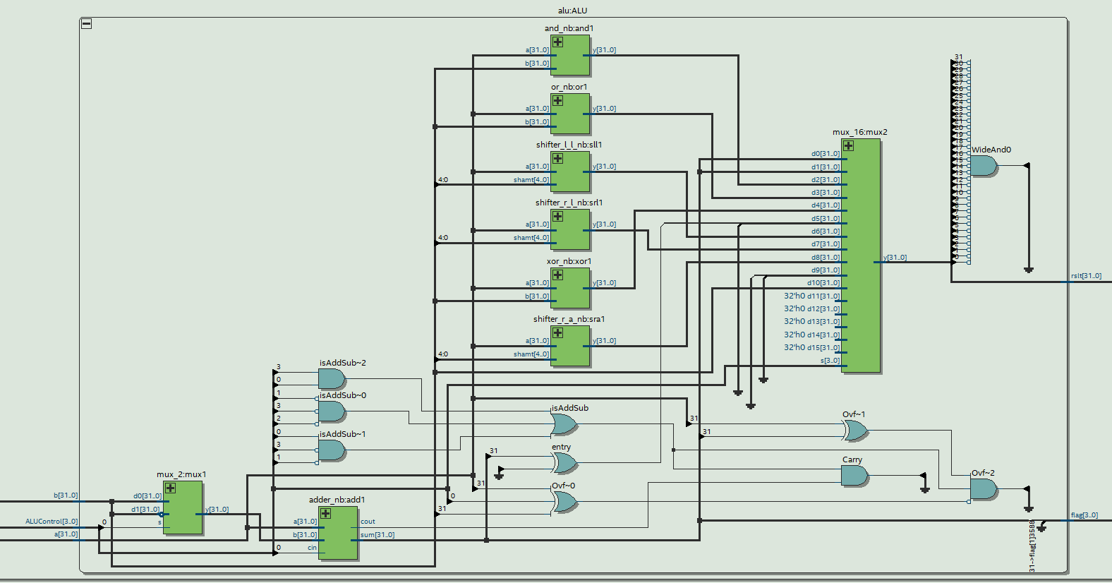
8. SYNTHESIS
Arithmetic Logical Unit (ALU)
Department of Electronics Engineering Capstone Project 1 Nguyễn Duy Ngọc June 5, 2025

Slide 85
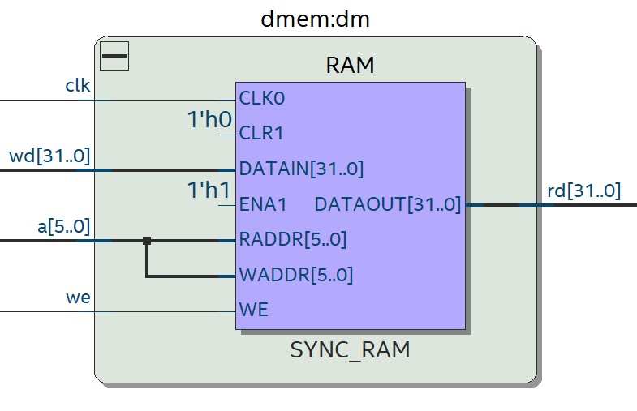
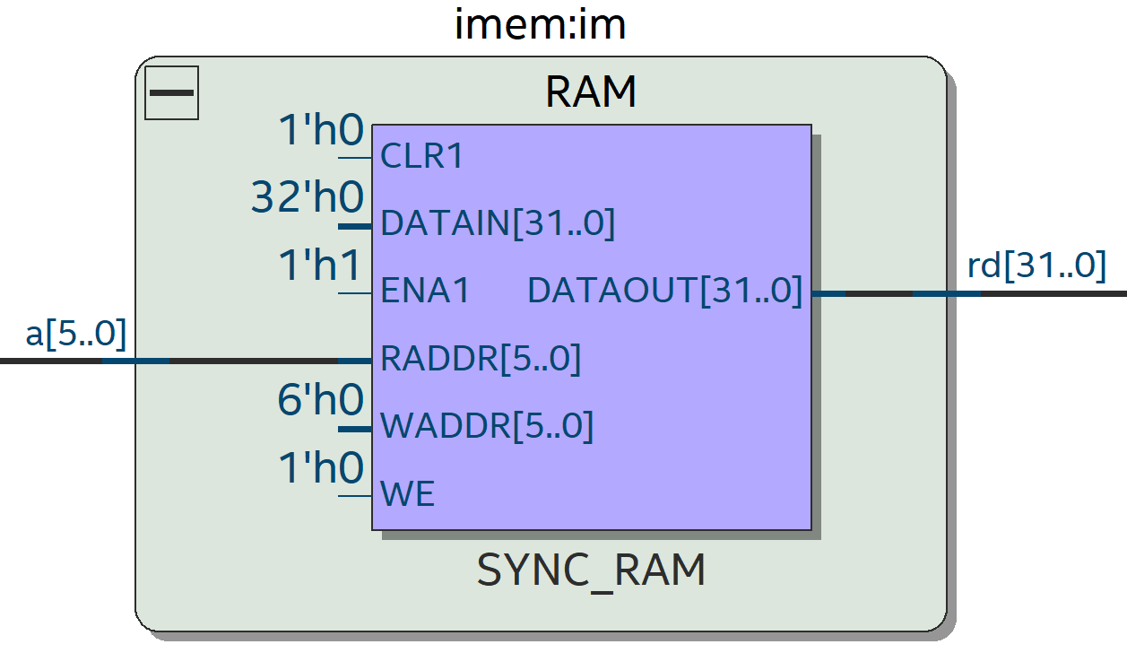
8. SYNTHESIS
Instruction and Data memories
Department of Electronics Engineering Capstone Project 1 Nguyễn Duy Ngọc June 5, 2025

Slide 86
9. WORKING DIRECTORY
Main Repository: gitlab.com/duyngoc131004/CapstoneProject1
Structure:
00_src/
01_bench/
10_sim/
20_syn/quartus/
90_docs/
91_scripts
91_report/
99_ref/
README.md
Department of Electronics Engineering Capstone Project 1 Nguyễn Duy Ngọc June 5, 2025

Slide 87
10. CONCLUSION - FUTURE VISION
Conclusion
Successfully built a pipelined RV32I processor
Fully tested and verified RTL
Synthesized
FPGA unproven
Department of Electronics Engineering Capstone Project 1 Nguyễn Duy Ngọc June 5, 2025

Slide 88
10. CONCLUSION - FUTURE VISION
Future vision
Advanced branch prediction
Instruction & data caching
Extend to RV32IM
Implement communication interfaces with TileLink, including bridges to I2C, UART, and SPI
Apply the Universal Verification Methodology (UVM) for advanced verification
Department of Electronics Engineering Capstone Project 1 Nguyễn Duy Ngọc June 5, 2025

Slide 89
THANK YOU FOR YOUR ATTENTION.

